Slide 1
CHAPTER 12
GUI BASICS

Slide 2
GUI Classes
Layouts
Color and Font
Panels as subcontainers
Color
Font
Image
JButton, JCheckBox, JRadioButton, JLabel, and JTextField

Slide 3
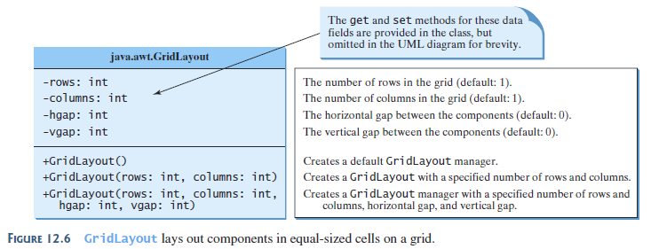
GridLayout
If the rows parameter is nonzero. The actual number of columns is calculated by the layout manager

Slide 4
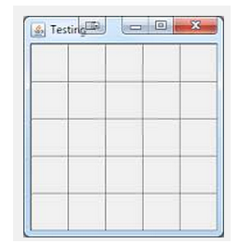
Example: GridLayout
5 rows, 5 columns

Slide 5
GridLayout
Fitting components into rows and columns
For the number of rows and columns
  Only one of them can be zero
  The zero dimension is then calculated based on the number of components to display
  For examples:
    You specify 3 rows, 0 column, 10 components
      Displays 3 rows, 4 columns (last row displays 2 components)
    You specify 0 rows, 3 columns, 10 components
      Displays 4 rows, 3 columns (last row displays 1 component)

Slide 6
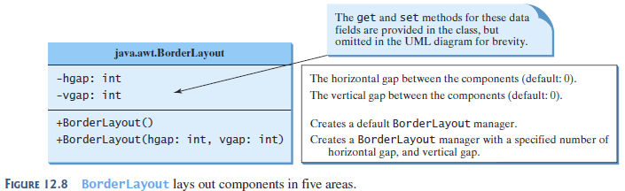
BorderLayout

Slide 7
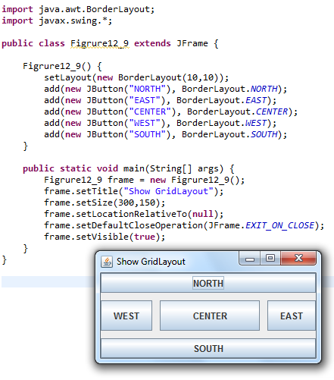
Example: BorderLayout

Slide 8
Helper Classes
We will do more with these classes next but actually they are intuitive to use:
  The Color Class
  The Font Class

Slide 9
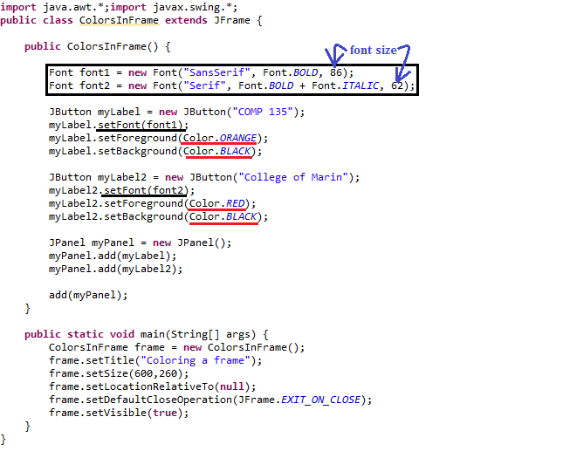
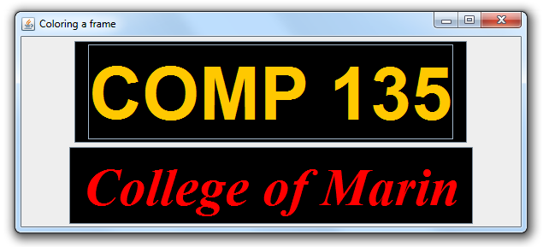
Example: Color and Font

Slide 10
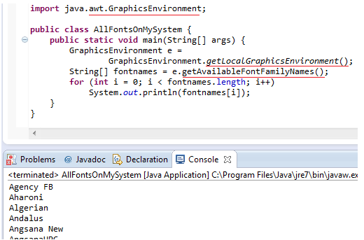
What fonts are available to me?

Slide 11
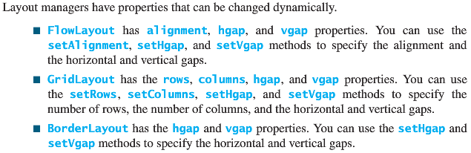
Properties and Methods

Slide 12
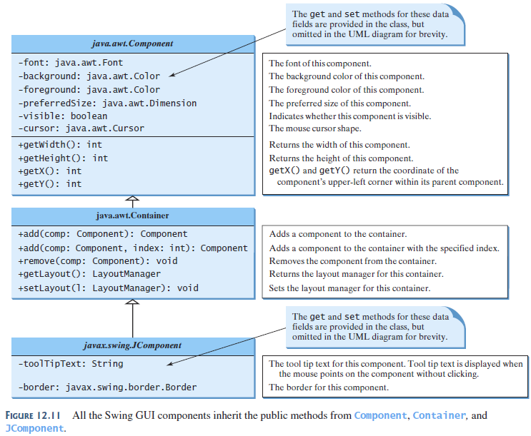
Common Features of Swing Components

Slide 13
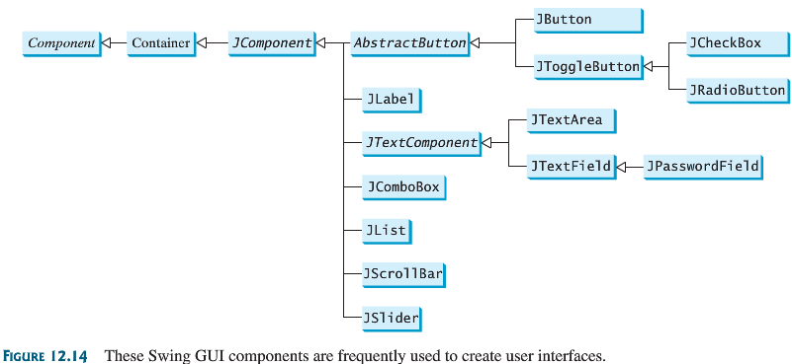
Swing GUI components

Slide 14
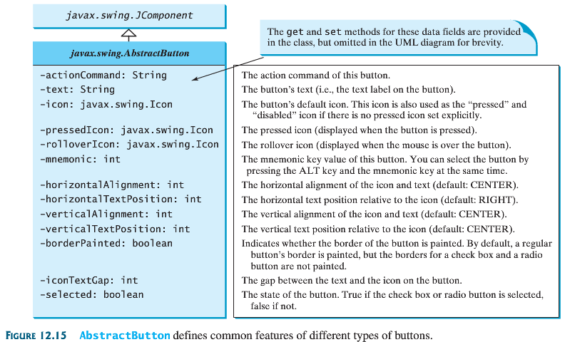
Javax.swing.AbstractButton

Slide 15
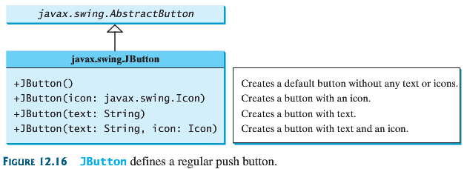
JButton

Slide 16
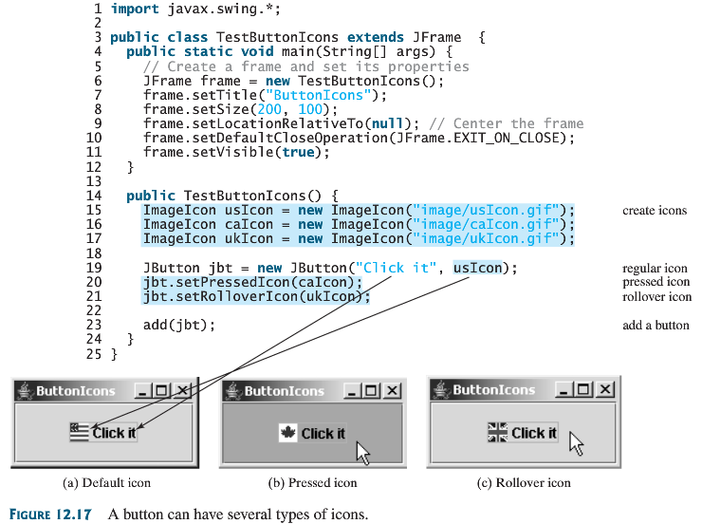
Example:
(Button Icons) Default, Pressed, Rollover

Slide 17
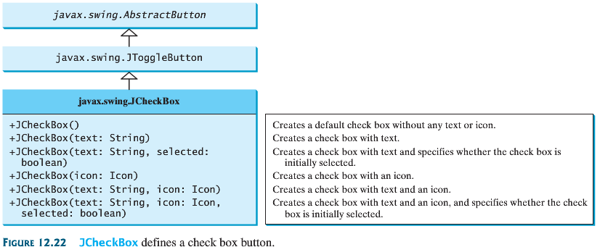
JCheckBox

Slide 18
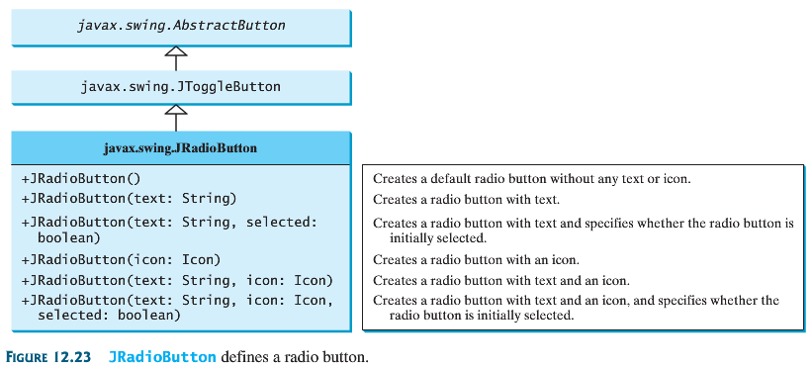
JRadioButton

Slide 19
Example RadioButton

Slide 20
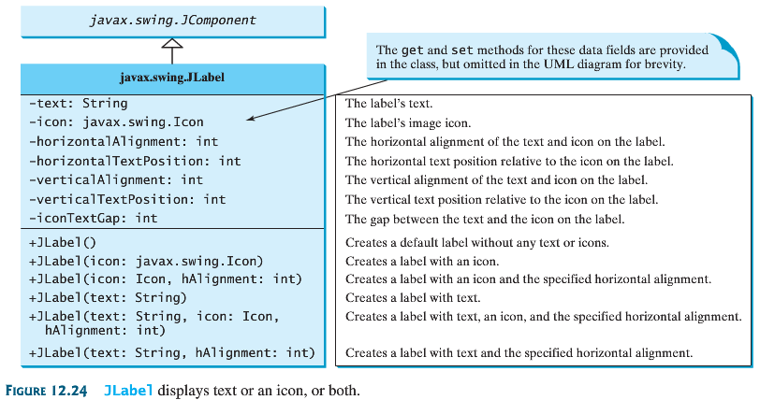
JLabel

Slide 21
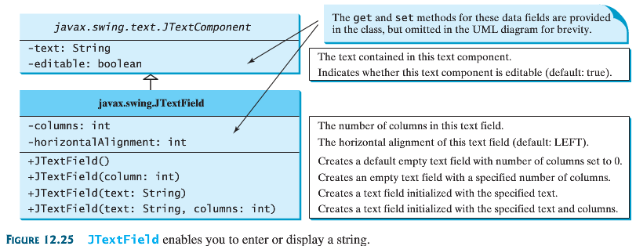
JTextField

Slide 22
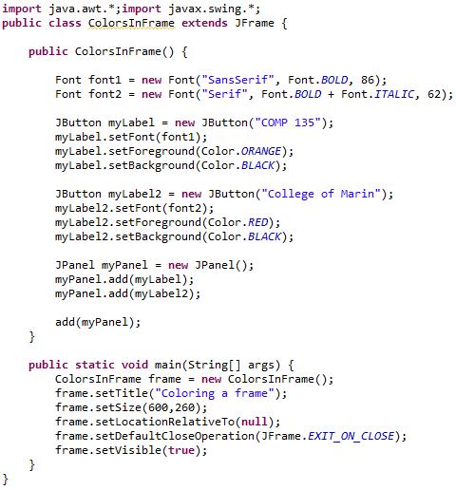
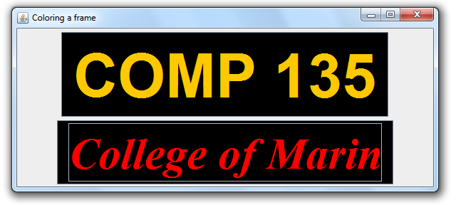

Slide 23
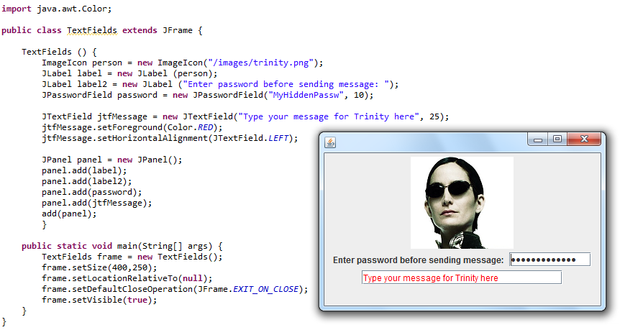
JLabel, JPasswordField, Color

Slide 24
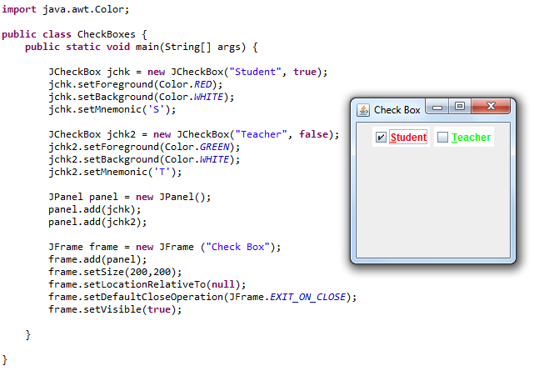
JCheckBox

Slide 25
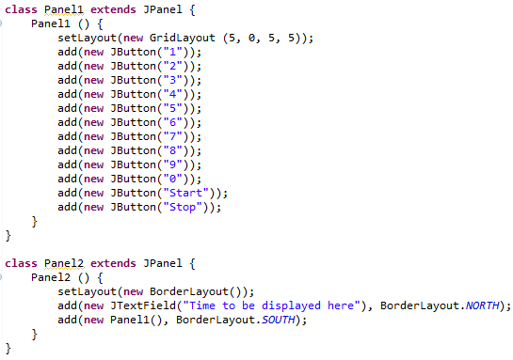
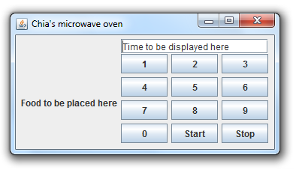
The Microwave
(GridLayout panel1, BorderLayout panel 2)
Use two panels
  Panel 1 (GridLayout) to hold number + Start/Stop buttons
  Panel 2 (BorderLayout) to hold a textfield including the whole panel 1

Slide 26
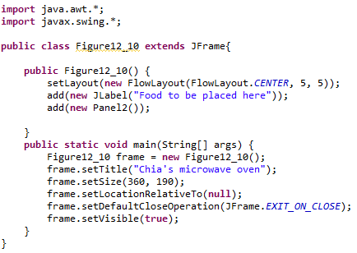
The Microwave (cont.)
Then drop a label “Food to be placed here” and panel 1 into the frame, in a flow layout

Slide 27
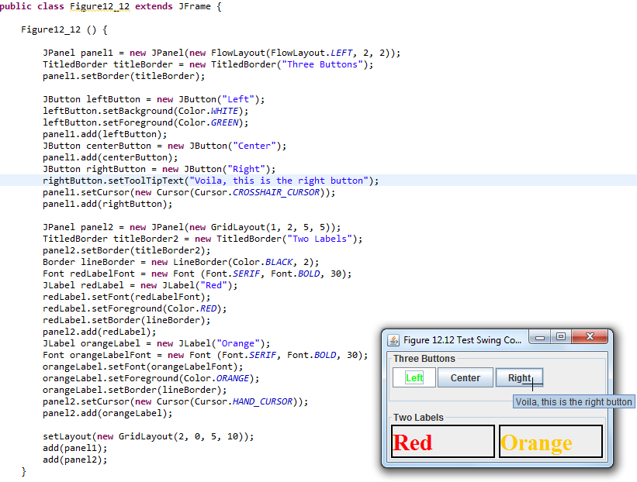
LineBorder, TitleBorder, and setToolTipText

Slide 28
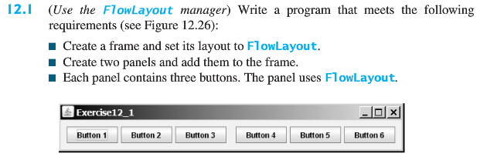
Lab exercises
Work with your group members
  One person typing up code
  ALL involved in building solution
We composed this the last time, use this as the starting point:

Slide 29
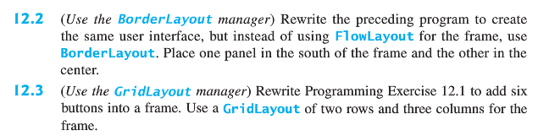
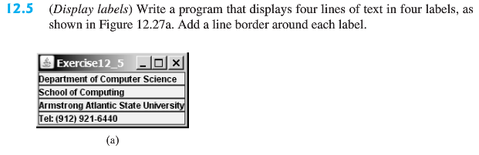

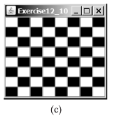

Slide 30
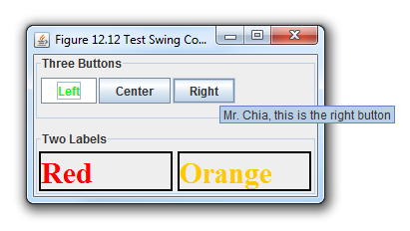
And lastly,

